Slide 1

A Transferable Adaptive Domain Adversarial Neural Network for Virtual Reality Augmented EMG-Based Gesture Recognition
《IEEE TRANSACTIONS ON NEURAL SYSTEMS AND REHABILITATION ENGINEERING》
Q1区，影响因子：3.34

Slide 2
INTRODUCTION
Muscle activity as a control interface has been extensively applied to a wide range of domains from assistive robotics to serious gaming for rehabilitation and artistic performances.
An important gap still exists between ofﬂine classiﬁers’ performances and real-time applications’ usability.
This disconnect stems in large part from the difﬁculty of including, within an ofﬂine dataset, the four main dynamic factors:
gesture intensity, limb position, electrode shift, and the transient nature of the EMG signal.
time investments & increase fatigue.
For real-world use, the system should ideally be able to learn to contend with untrained conditions.
participants cannot regulate their gestures through external feedback due to the absence of a controller
forced to rely on internal focus
behavior & EMG signals
Consequently, the recording of a new dataset for each control method or variant to be tested is required for a fair comparison. Recording such datasets, however, is not only time-consuming but can also require expensive hardware.
Virtual reality (VR) offers an attractive and affordable environment for EMG-based real-time 3D control simulations.
As such, one of this work’s contributions is the creation of a virtual reality environment from which a dynamic dataset, featuring 20 participants and recorded speciﬁcally to contain the four main dynamic factors, is made publicly available.（the real-time, gesture recognition feedback is provided solely by a Leap Motion camera）
Using the dynamic dataset, this work proposes an analysis of the effect of the four main dynamic factors on a deep learning classiﬁer.
A new transfer learning algorithm for long-term recalibration, named Transferable Adaptive Domain Adversarial Neural Network (TADANN).

Slide 3
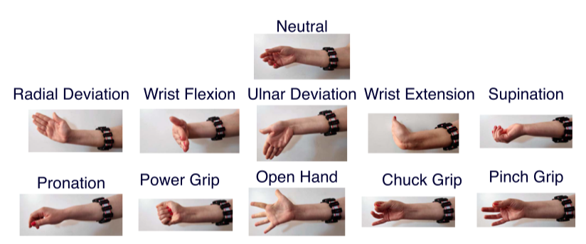
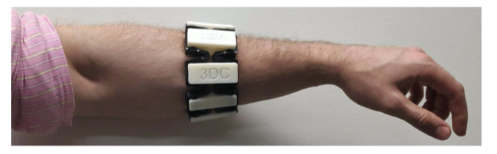
Long-Term sEMG Dataset
publicly available: https://github.com/UlysseCoteAllard/LongTermEMG
LongTerm 3DC Dataset is available here: http://ieee-dataport.org/1948
3DC Dataset is available here: https://github.com/UlysseCoteAllard/sEMG_handCraftedVsLearnedFeatures
The Dynamic Dataset features 20 able-bodied participants (5F/15M) aged between 18 and 34 years old (average 26 ± 4 years old) performing the eleven hand/wrist gestures.
For each participant, the experiment was recorded in virtual reality over three sessions spanning 14 days.
In addition to this minimum requirement, six of them completed a fourth session, so that the experiment spanned 21 days. 17 of the 20 participants had no prior experience with EMG systems, while the other three only had limited experience.(18 of the 20 participants, this was their ﬁrst time within a VR environment.)

Slide 4
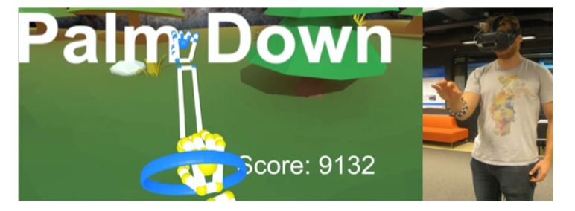
Long-Term sEMG Dataset
sEMG Recording Hardware:
3DC Armband(a wireless, 10-channel 1000Hz, dry-electrode, 3D printed sEMG armband.)
a 9-axis Magnetic, Angular Rate, and Gravity (MARG) sensor cadenced at 50 Hz.
Stereo-Camera Recording Hardware
Leap Motion camera(https://www.ultraleap.com/)
Experimental Protocol in Virtual Reality
Enables the software to intuitively communicate gesture intensity and position (in 3D) to the participant via the graphic interface.
The arm of the participant was replaced within the VR environment by a virtual prosthetic providing direct, intuitive feedback (gesture detected, intensity, and position) to the participant.
Allows the experimental protocol to be easily gamiﬁed, which greatly aids both recruitment and participant retention.
The Leap Motion, in conjunction with a picture-based convolutional network is used as the real-time controller to provide feedback to the user without biasing the dataset toward a particular EMG-based classiﬁer.
Each recording session is divided into two parts:
the Training Session and the Evaluation Session, both of which are conducted in VR.

Slide 5
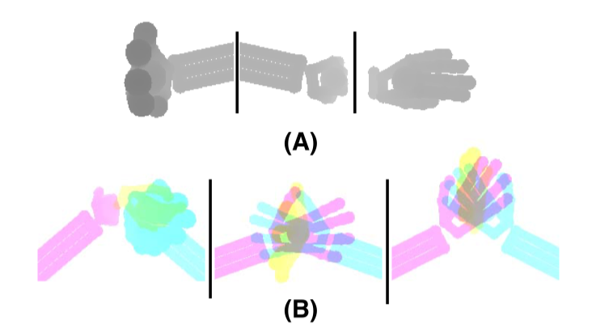
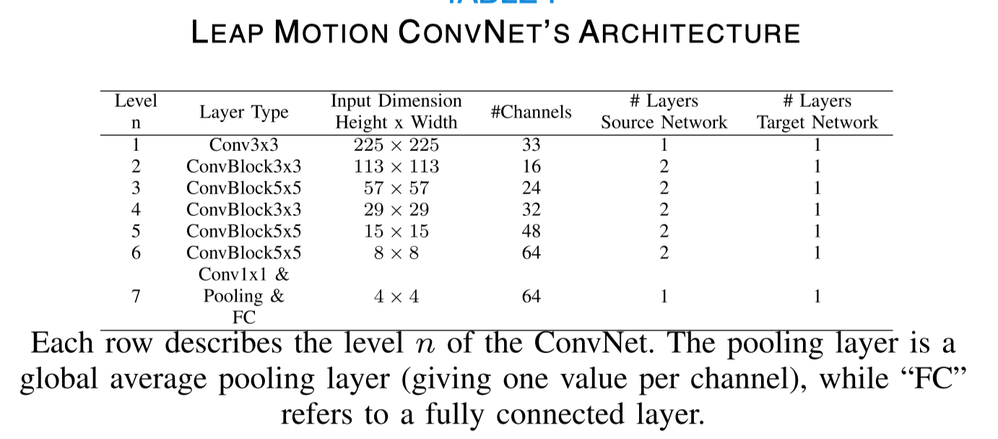
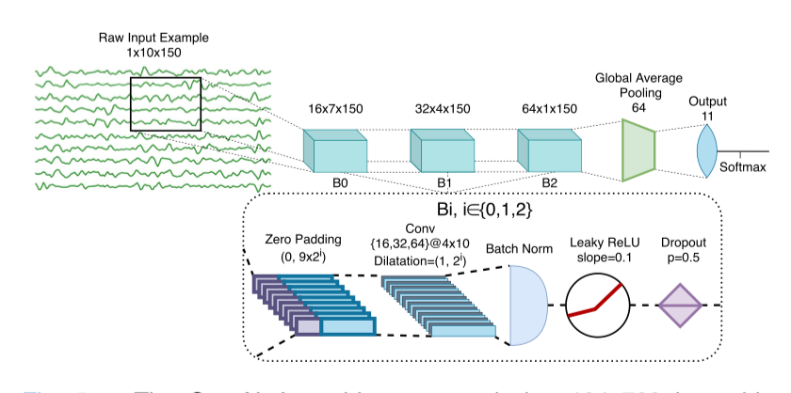
Deep Learning Classifiers
Leap Motion Convolutional Network
EMG-Based Temporal Convolutional Network
Calibration Training Methods
No Calibration
Recalibration
Delayed Calibration

Slide 6
Transfer Learning
Adaptive Domain Adversarial Neural Network (ADANN)
Transferable Adaptive Domain Adversarial Neural Network (TADANN)
During pre-training, each session within the pre-calibration sessions is considered as a separate labeled domain dataset.
At each epoch, pre-training is performed by sharing the weights of a network across all the domains (i.e. pre-calibration sessions), while the Batch-Normalization (BN) statistics are learned independently for each session.
After pre-training, the learned weights are frozen, except for the BN parameters, which allows the network to adapt to a new session.
Then, a second network is initialized and connected with an element-wise summation operation in a layer-by-layer fashion to the pre-trained network.
At each epoch, for each step, a mini-batch is created containing examples from a single, randomly selected session at a time.
A second mini-batch is then created from an also randomly selected session
After pre-training, the learned weights are frozen, except for the BN parameters, which allows the network to adapt to a new session.
Then, a second network is initialized (in this work, the second network is identical to the pre-trained network) and connected with an element-wise summation operation in a layer-by-layer fashion to the pre-trained network.
Additionally, all outputs from the pre-trained network are multiplied by a learnable coefﬁcient (clamped between 0 and 2) before the summation, as to provide an easy mechanism to neuter or increase the inﬂuence of the pre-trained network at a layer-wise level.

Slide 7
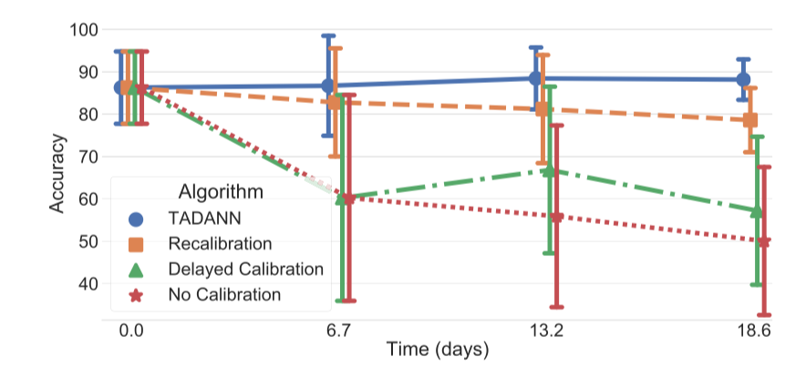
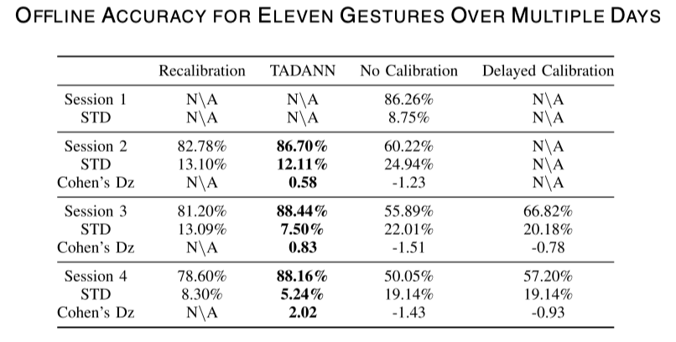
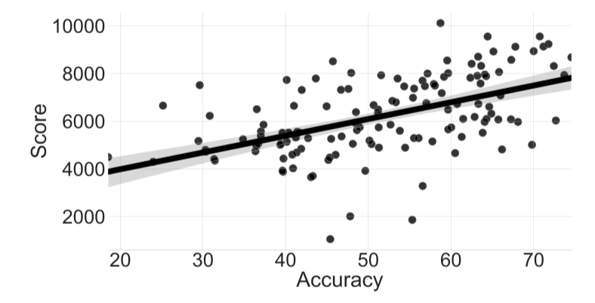
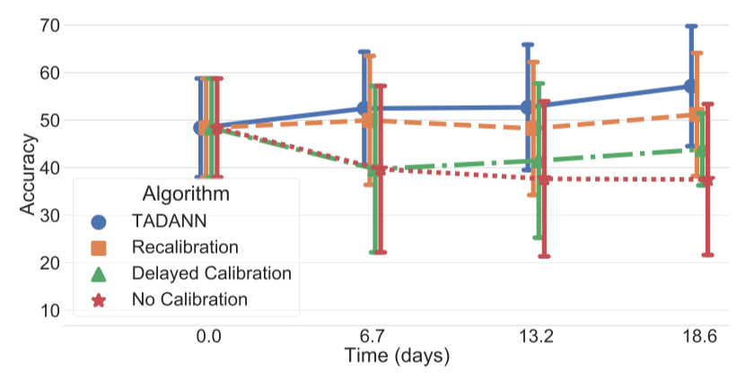
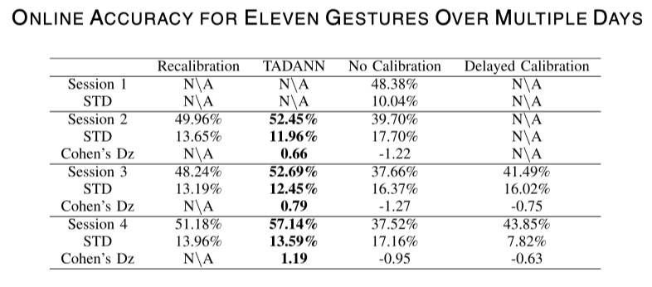
Result
Training Sessions: Over Time Classiﬁcation Accuracy
Evaluation Session
The Pearson r correlation coefﬁcient between the score and accuracy is 0.52.

Slide 8
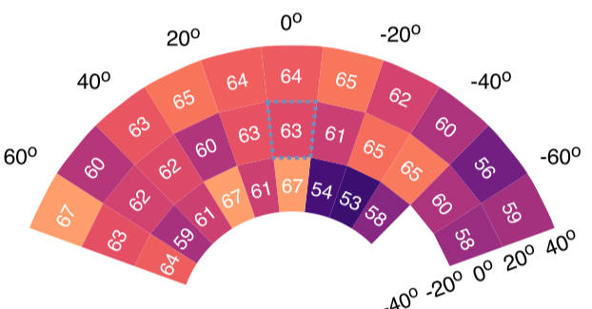
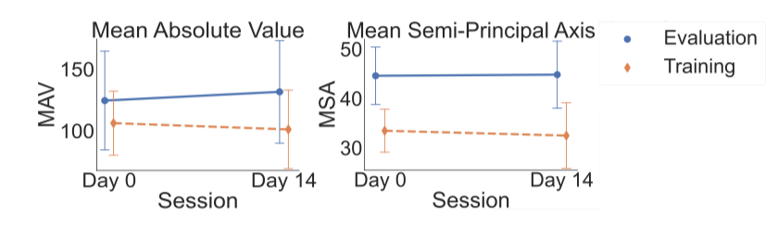
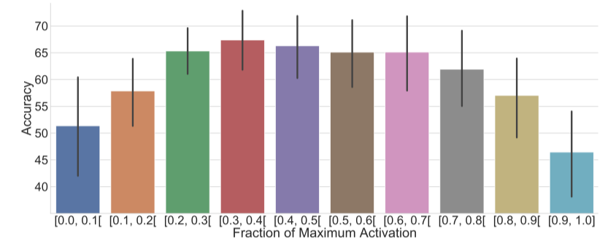
Result
Evaluation Session
Accuracy with respect to the pitch and yaw angles.

Slide 9
Discussion:
This paper presents a new VR experimental protocol for sEMG-based gesture recognition, leveraging the Leap Motion camera so as to not bias the online dataset.
Quantitatively and qualitatively, the participants were shown to improve over time and were motivated in taking part in the experiment.
The proposed TADANN algorithm was shown to consistently achieve higher accuracy than using ﬁne-tuning to recalibrate the network.
The VR environment in conjunction with the Leap Motion allowed for the quantiﬁcation of the impact of limb position with, to the best of the authors’ knowledge, the highest resolution yet.
Limitations:
The main limitation of this study is the relatively important gap between sessions.
While such a scenario is realistic (e.g. for a consumer-grade armband used to play video games or artistic performances) it is not possible to smoothly evaluate the change in signals within days.
It only considers discrete gesture feedback during the Evaluation Sessions.

